Slide 1
HR Analytics Dashboard Project
Prepared By: Deepika S
Tool Used: Google Sheets

Slide 2
Project Objective
Objective:
To analyze HR employee data using Google Sheets and understand employee distribution, employee status, and business unit allocation.
Business Questions:
1. Which department has the highest number of employees?
2. What is the employee termination rate?
3. How are employees distributed across business units?

Slide 3
Dataset Overview
Dataset: HR Employee Data
Total Employees: 2845
Tool Used: Google Sheets
Analysis Performed:
• Department-wise Employee Count
• Business Unit-wise Employee Count
• Employee Status Distribution

Slide 4
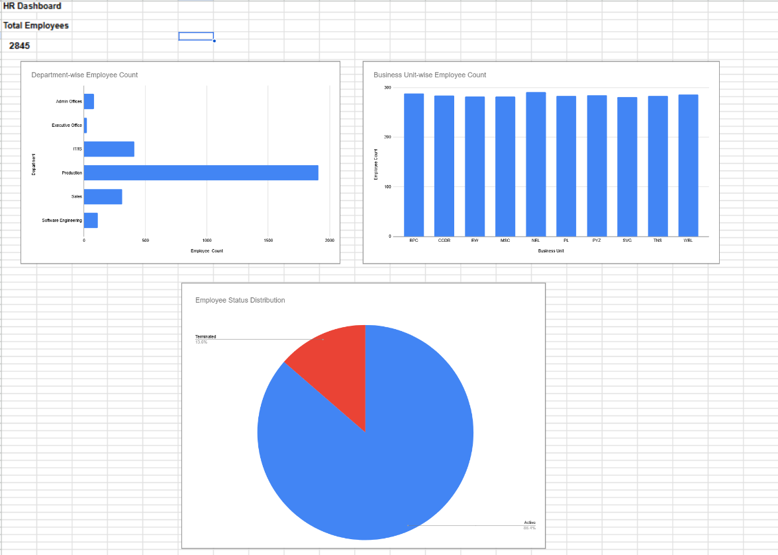
HR Analytics Dashboard

Slide 5
Key Findings
1.Which department has the highest number of employees?
Production Department has the highest number of employees.
2.What is the employee termination rate?
Active Employees: 86.4%
Terminated Employees: 13.6%
3.How are employees distributed across business units?
Employees are distributed almost equally across all business units.

Slide 6
Recommendations
1. Focus on employee retention strategies to reduce termination rates.
2. Monitor workforce distribution in the Production Department.
3. Continue maintaining balanced staffing across business units.
4. Regularly track employee performance and engagement.

Slide 7
Conclusion
The HR Analytics Dashboard provides valuable insights into workforce distribution and employee status.
The analysis shows that the organization maintains a stable workforce with a high percentage of active employees and balanced employee allocation across business units.
THANK YOU

